Slide 1
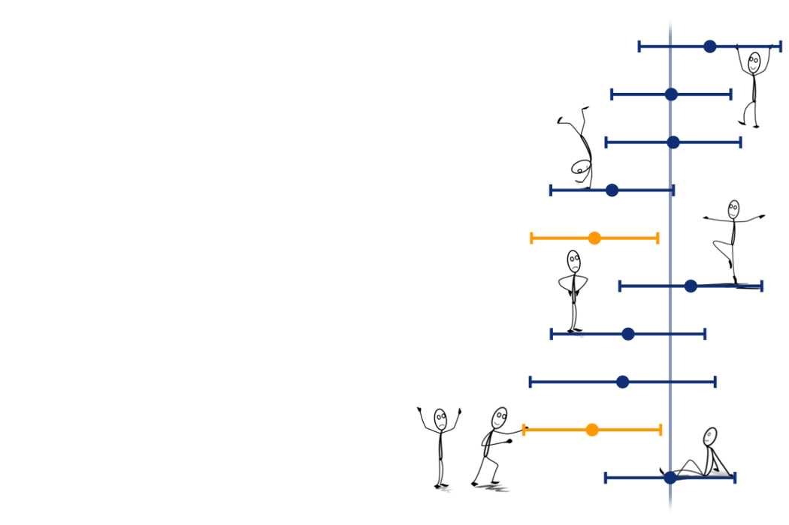
Uncertainty, standard errors and confidence intervals
Martina Sladekova

Slide 2
Today…
Recap of sampling from populations
Uncertainty in research and estimation
Sampling distribution revisited
Standard error of the mean
Confidence intervals: what they are, and what they are not
Notes:
Add alt text to images

Slide 3
Recap of sampling

Slide 4
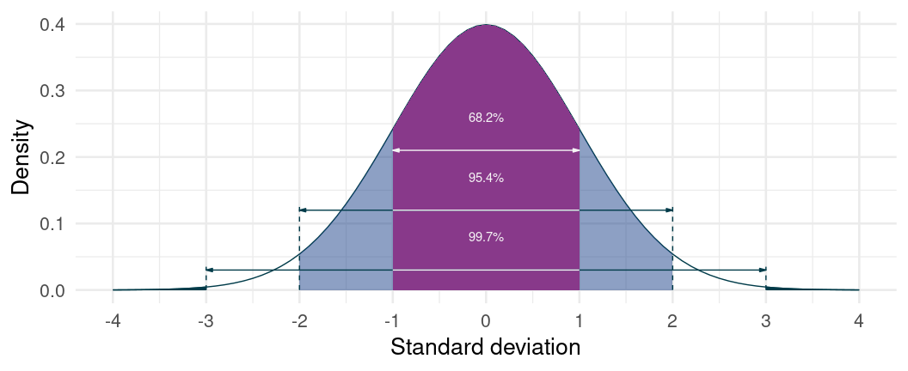
Recap
Distributions describe how often different values occur - in a sample or a population. They can take any shape - if they’re “algebraically tractable”, we can describe them with a formula.
Normal distribution - defined by mean, standard deviation, and proportions of scores expected above/below critical values

Slide 5
Recap
Key idea
Assuming a distribution of a particular shape, how common is a given value?

Slide 6
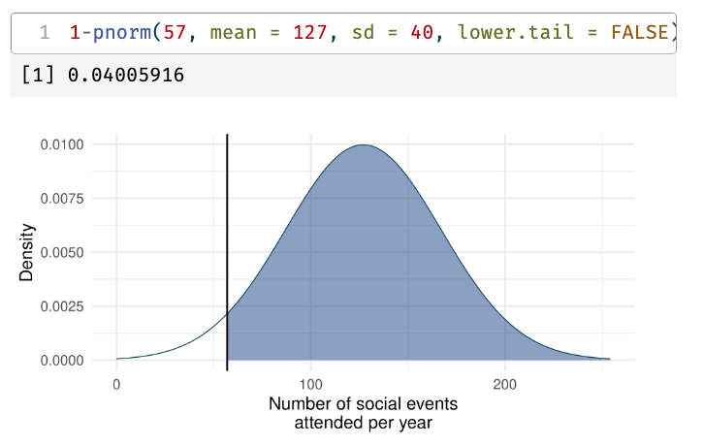
E.g. is an individual who attends 57 social events per year unusual?
In a normal distribution with M = 127 (social events attended per year) and SD = 40, only 4 % of people attend less than 57 events per year.

Slide 7
Recap
Key idea
Assuming a distribution of a particular shape, is the value we’re interested in above or below a specific cut-off point?

Slide 8
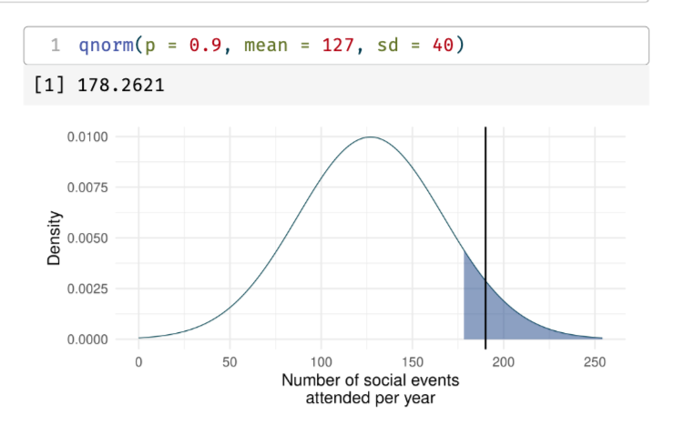
E.g. is an individual who attends 190 social events per year among the top 10% of event-goers?
In a normal distribution with M = 127 (social events attended per year) and SD = 40, an individual would have to attend 76 events or more to be in the top 10% of event goers.
Therefore a person who attends 190 events is in the top 10%.

Slide 9
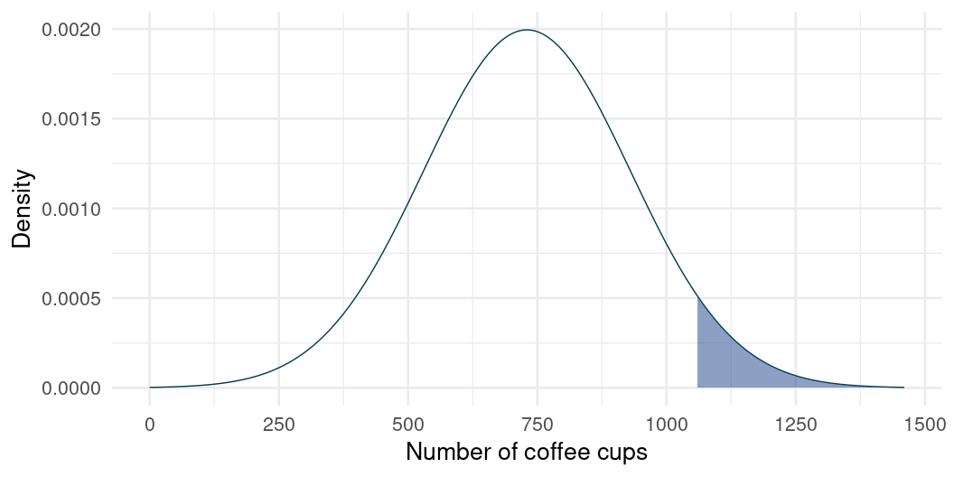
Let’s practice (1)
Example 1: Average individual drinks 730 cups of coffee per year. John drinks 1100 cups of coffee per year. Is John in top 5% of the distribution (shaded)?

Slide 10
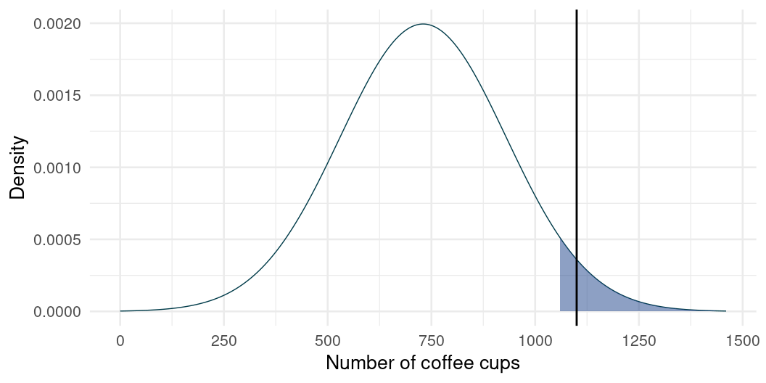
Let’s practice (1)
Example 1: Average individual drinks 730 cups of coffee per year. John drinks 1100 cups of coffee per year. Is John in top 5% of the distribution (shaded)?

Slide 11
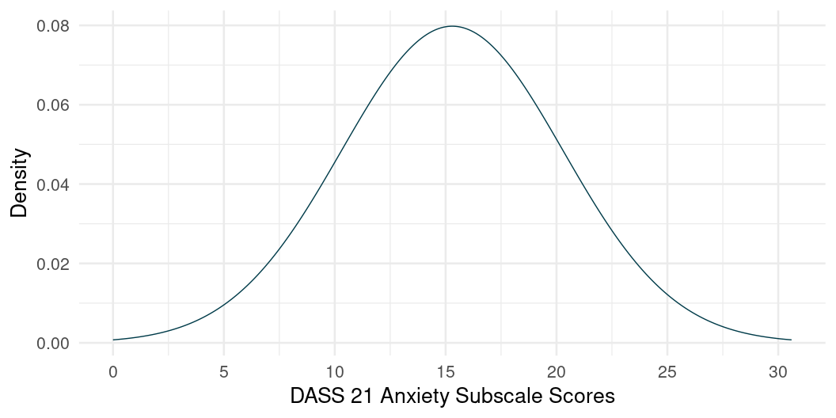
Let’s practice (2)
Example 2: A critical value for top 5% on an anxiety scale is 23.5. A study participant receives a score of 19. Are they in the top 5%?

Slide 12
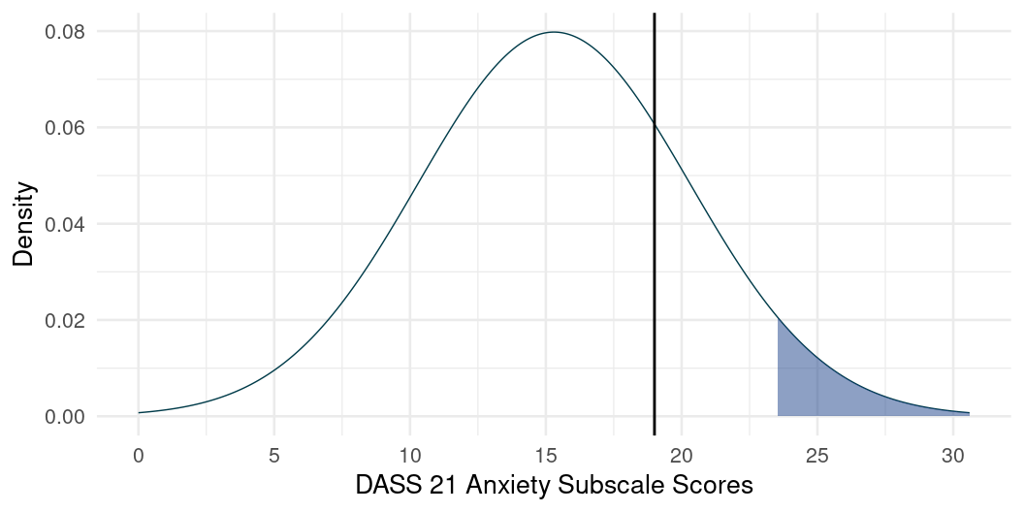
Let’s practice (2)
Example 2: A critical value for top 5% on an anxiety scale is 23.5. A study participant receives a score of 19. Are they in the top 5%?

Slide 13
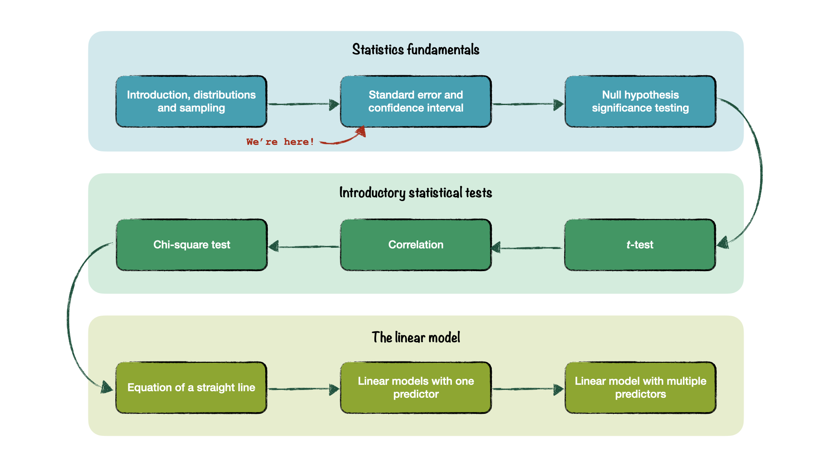
Roadmap!

Slide 14
Uncertainty in estimation

Slide 15
Population distribution is often unknown
Last week - example of a population distribution with known mean and SD
In research - the setup is often the other way around. We don’t know what the population distribution looks like, and we’re trying to figure this out from our sample.
Collect a random sample
Measure the individuals in our sample on some variable (e.g. social events attended, anxiety scores, time spent on social media, stress levels… )
Calculate mean and SD of the sample and use to infer what the population distribution could look like (i.e. we want to generalise) .

Slide 16
Population distribution is often unknown
THE PROBLEM: Each time we take a sample, we get different values
So there is uncertainty around how close the sample mean is to the true population value.
Standard errors and confidence intervals are tools we use to quantify that uncertainty.

Slide 17
Sampling from populations
We want to learn something about the population
But we only have access to a sample (often a small one)
The sample estimate is our best guess

Slide 18
What is an estimate?
An estimate can take many different forms. For example, we might be interested in comparing groups, in which case the estimate can be the difference in group means on some variable of interest. Or we might want to know whether two variables are associated, where the estimate is some measure of association (e.g. a correlation coefficient, or a b value which will be covered later in the term).

Slide 19
Some average facts
The average person…
drinks 730 cups of coffee per year (twice as much for academics, incl. students) ☕
spends 192 minutes a day watching TV 📺
eats 250 cloves of garlic per year 🧄
takes 3500 steps each day 🚶
falls asleep in 7 minutes 😴

Slide 20
Doomscrolling
“… refers to a unique media habit where social media users persistently attend to negative information in their newsfeeds about crises, disasters, and tragedies.”
- Sharma, Lee, and Johnson (2022)

Slide 21
Research question…
How much does an average person doomscroll?

Slide 22
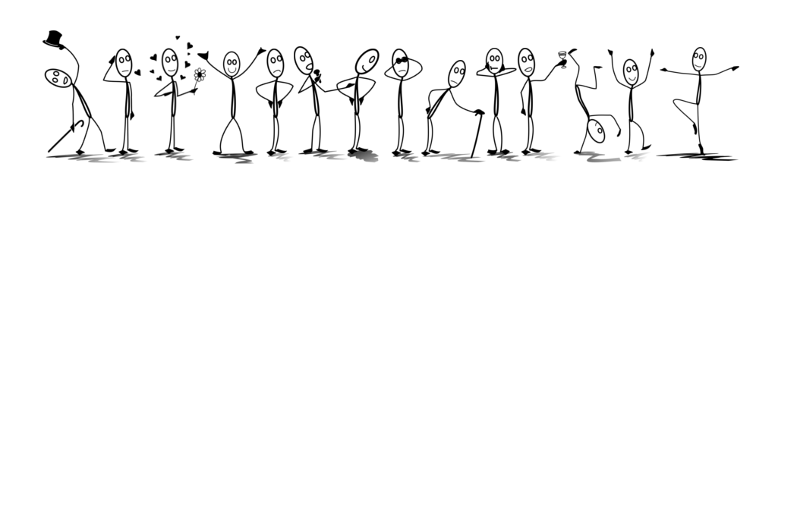

Slide 23
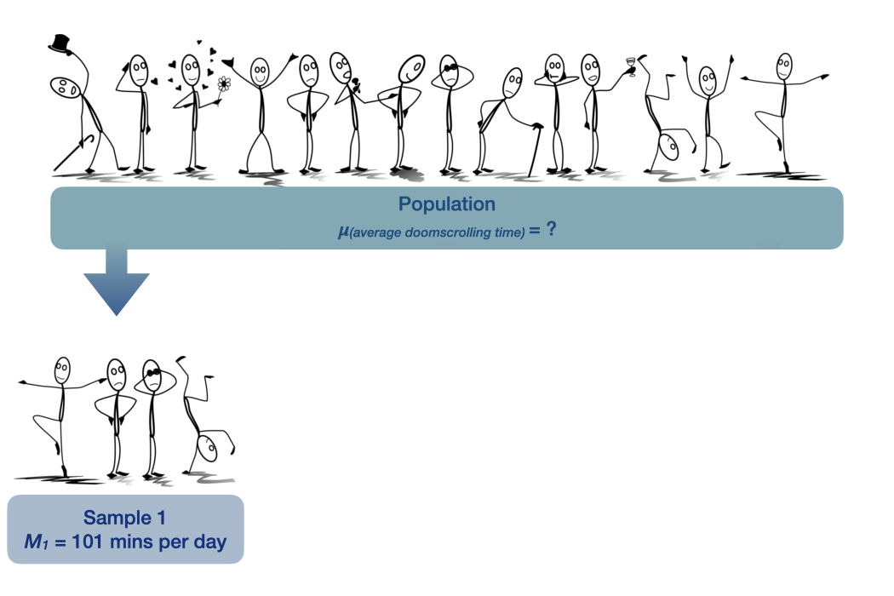

Slide 24
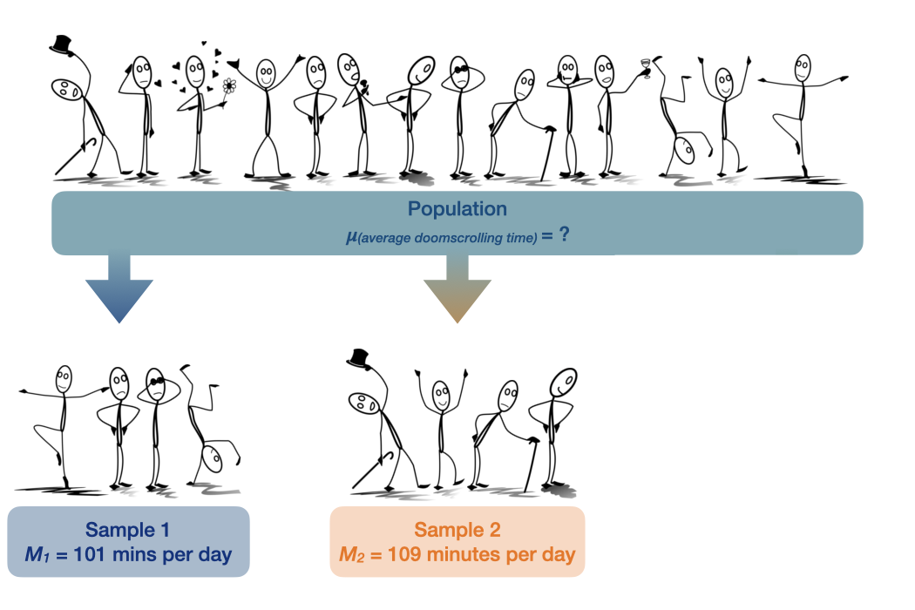

Slide 25
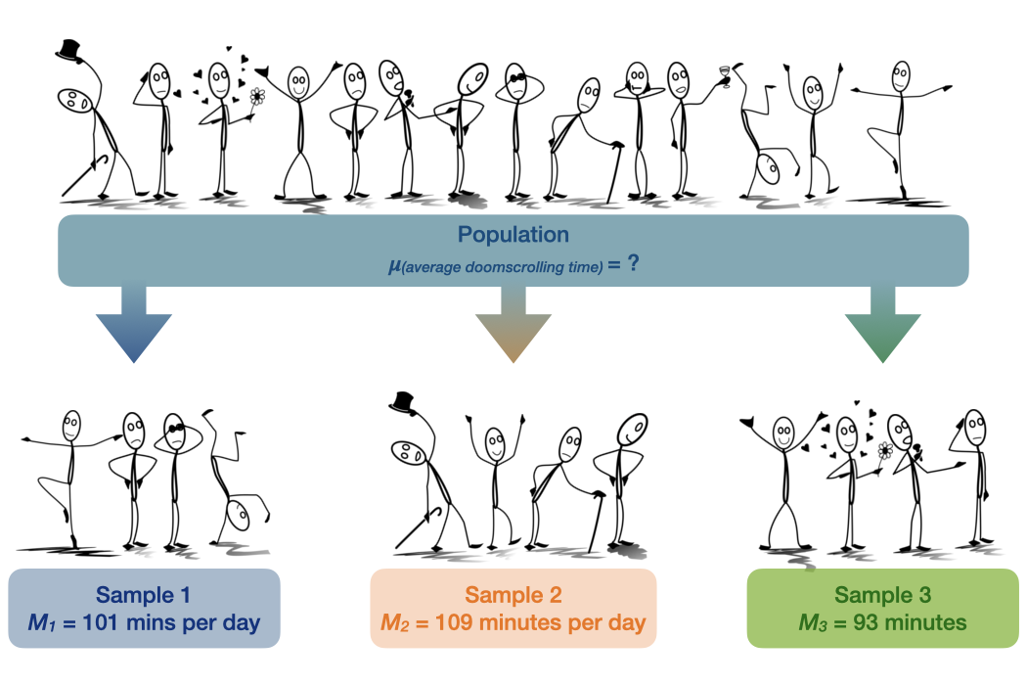

Slide 26
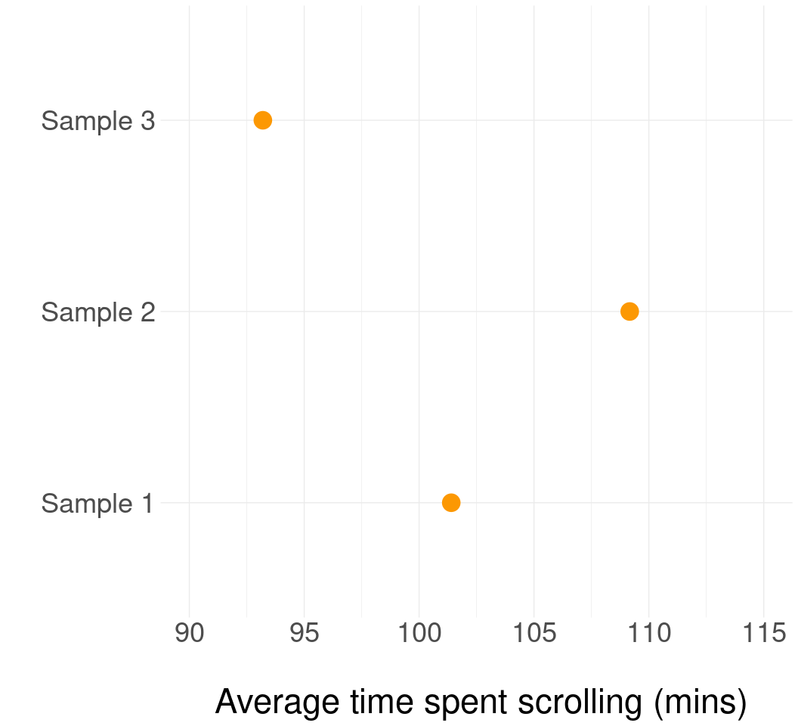
Uncertainty in research and estimation
Each time we take a sample, we get a different estimate because we are sampling randomly
How do we know if our estimate is accurate and close to the real population value?

Slide 27
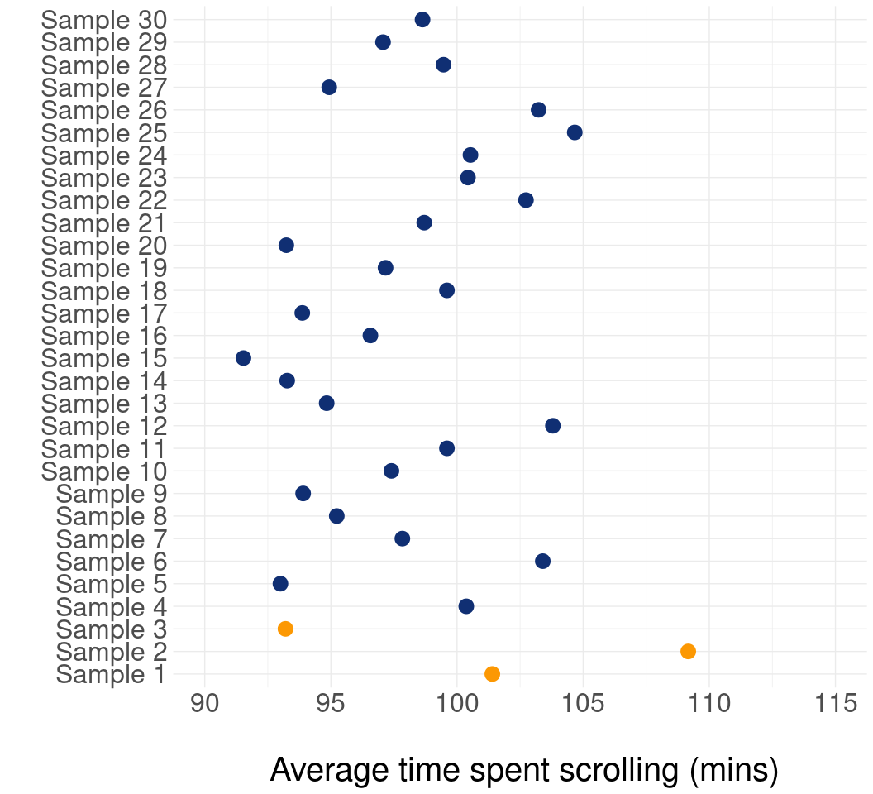
Each time we take a sample, we get a different estimate.
How do we know if our estimate is accurate and close to the real population value?
ANSWER: We don’t. We conduct some statistical wizardry and hope for the best.

Slide 28
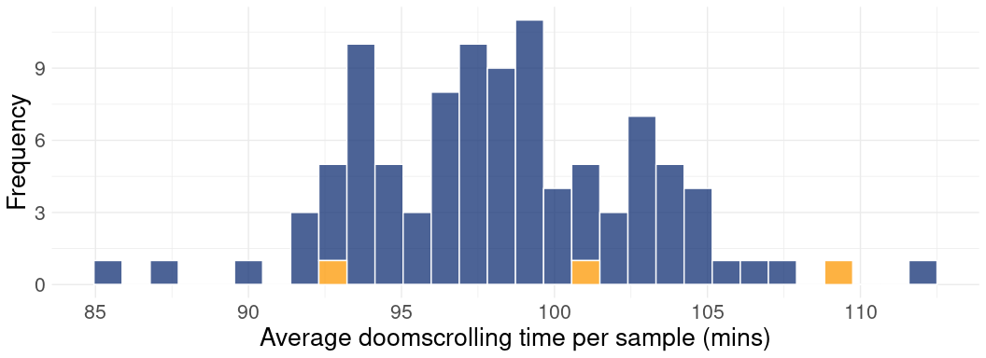
Sampling distributions
We can plot the sample estimates in a histogram to see how they’re distributed
We’re now working with sample means, not the scores of individual people. Therefore the plot below shows a sampling distribution.
x axis shows the sample means, y axis shows how many times each mean occurs

Slide 29
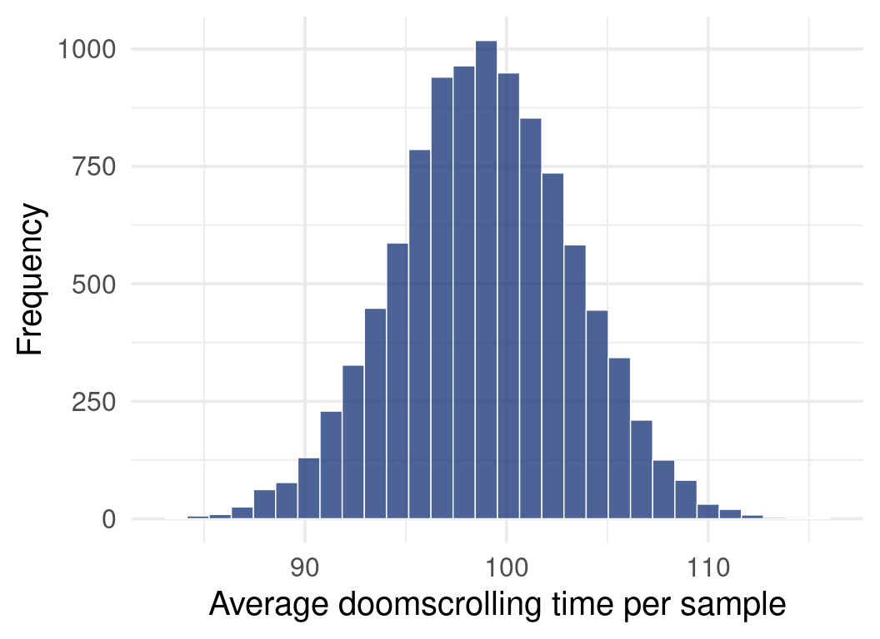
Central Limit Theorem revisited
We can repeat the process infinite number of times
For many types of estimates, including means, the sampling distribution will be normal
This is because of the Central Limit Theorem
This is true as long as the samples that we’re taking are large enough
If each sample has only 3 participants, the sampling distribution might not end up being normal
Textbooks often say that 30 is enough, but there are situations when we might need more
Let’s put a pin in this and we’ll get back to it later 📌

Slide 30
Standard error

Slide 31
Normal distribution - what we already know
We can describe every normal distribution using:
Mean - the central value
Standard deviation (SD) - the average difference from the mean
Proportions of scores at cut-off points
Around 68% of scores are within 1 SD of the mean
95% of scores are within $±$ 1.96 SDs of the mean

Slide 32
Normal sampling distribution
Same rules apply!
The mean of a sampling distribution will be centered on the population value
LANGUAGE CHANGE: when talking about standard deviation in the context of a sampling distribution, we call it standard error.
Standard deviation
The average difference between each score and the sample mean
Standard error
Standard deviation of sample means
The average difference between each sample mean and the population value

Slide 33
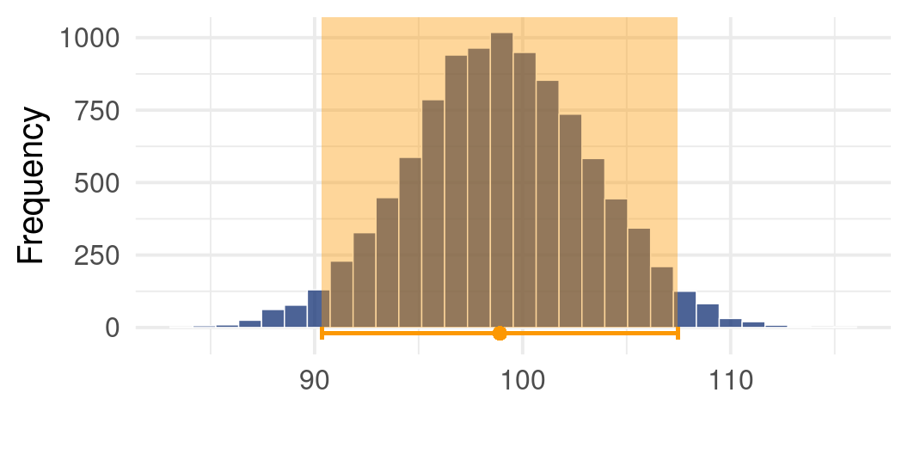
Normal sampling distribution
We know that 95% of scores will fall within 1.96 standard errors from the population mean
We can use this knowledge to construct an interval around the mean - 95% of sample means will fall within this interval.

Slide 34
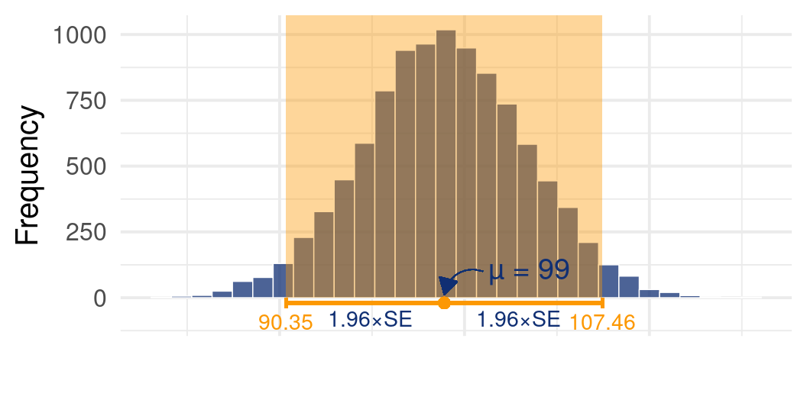
Normal sampling distribution
We know that 95% of scores will fall within 1.96 standard errors from the population mean
We can use this knowledge to construct an interval around the mean - 95% of sample means will fall within this interval.

Slide 35
Standard error
Standard error is a useful metric for quantifying uncertainty in estimates - it describes the extent to which samples differ from each other in a sampling distribution
We can use it to construct an interval within which a certain percentage of sample means will fall
Let’s make things more complicated…

Slide 36

Standard error

Slide 37
Estimating the standard error from the sample
Warning
Error 404:Sampling distribution not found.
Sampling distributions don’t exist “in the wild”. They are a hypothetical statistical concept.
Remember: standard error refers to the standard deviation of the sampling distribution (created by re-sampling and computing the mean infinite number of times), but we only have access one sample with one mean.
Therefore, if we want to use the standard error to construct an interval, we need to estimate it from our sample.

Slide 38
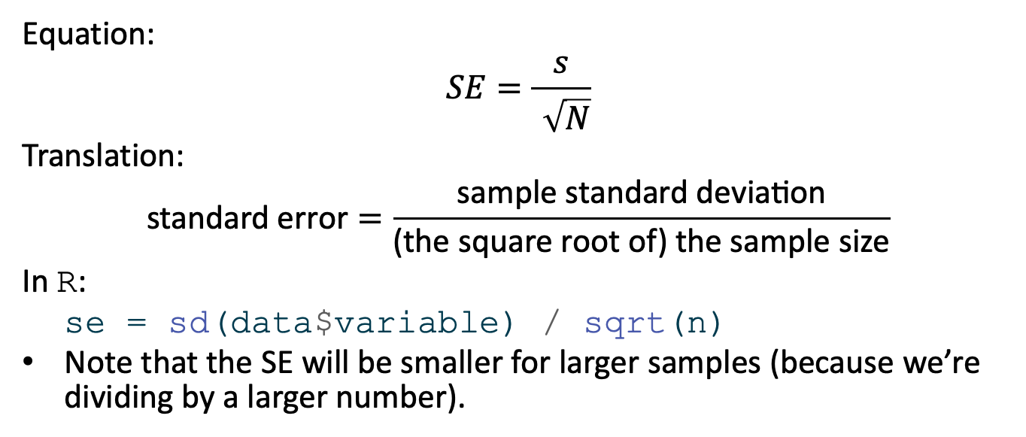
Estimating the standard error from the sample
Equation:
$$SE=\frac{s}{\sqrt{N}}$$
Translation:
$$\text{standard} \text{error}=\frac{\text{sample} \text{standard} \text{deviation}}{\text{(}\text{the} \text{square} \text{root} \text{of}\text{) }\text{the} \text{sample} \text{size}}$$
In R:
se = sd(data$variable) / sqrt(n)
Note that the SE will be smaller for larger samples (because we’re dividing by a larger number).

Slide 39
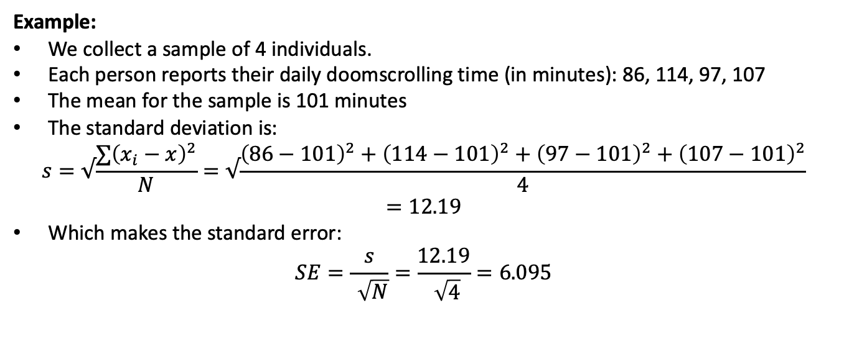
Estimating the standard error from the sample
Example:
We collect a sample of 4 individuals.
Each person reports their daily doomscrolling time (in minutes): 86, 114, 97, 107
The mean for the sample is 101 minutes
The standard deviation is:
$$s=√\frac{∑{\left(x_{i}−x\right)}^{2}}{N}=√\frac{{\left(86−101\right)}^{2}+{\left(114−101\right)}^{2}+{\left(97−101\right)}^{2}+{\left(107−101\right)}^{2}}{4}=12.19$$
Which makes the standard error:
$$SE=\frac{s}{\sqrt{N}}=\frac{12.19}{\sqrt{4}}=6.095$$

Slide 40
Confidence intervals

Slide 41
Confidence intervals
Average doomscrolling time for the sample: 101 minutes
Standard deviation: 12.19
Standard error: 6.095
Lower CI limit = sample mean - 1.96 x SE Upper CI limit = sample mean + 1.96 x SE
Lower CI limit = 101 - 1.96 x 6.095 = 89.054 Upper CI limit = 101 + 1.96 x 6.095 = 112.946

Slide 42
You might see in a paper…
“The average doomscrolling time in our sample was 101 minutes (SD = 12.19) 95% CI [89.05, 112.95].”

Slide 43
Confidence intervals for small samples
📌 Sampling distribution of the mean will have a normal shape as long as the sample size large enough
Smaller samples don’t approximate the normal sampling distribution very well. Because of this, we can’t rely on the value 1.96 to give us accurate intervals.

Slide 44
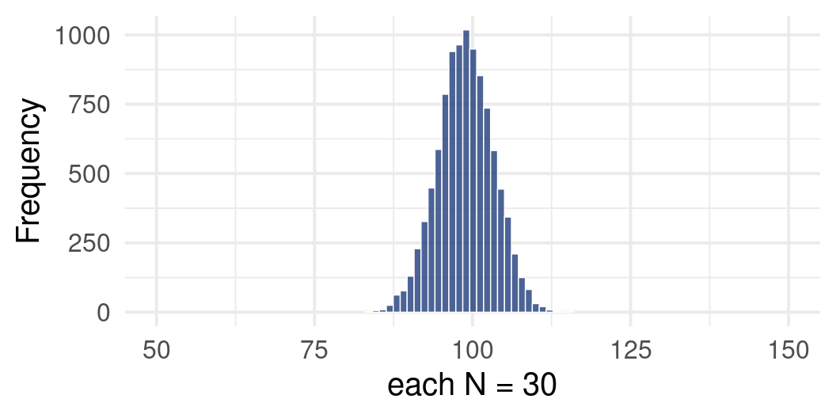
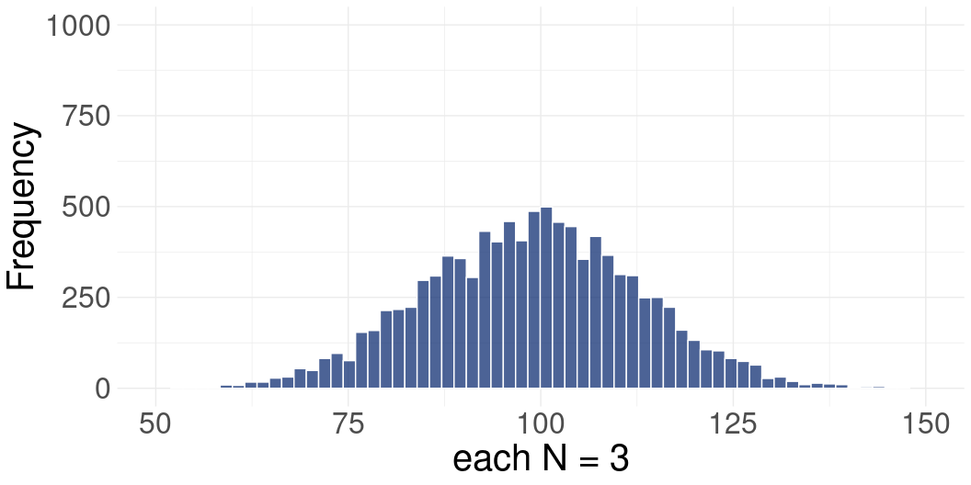


Slide 45
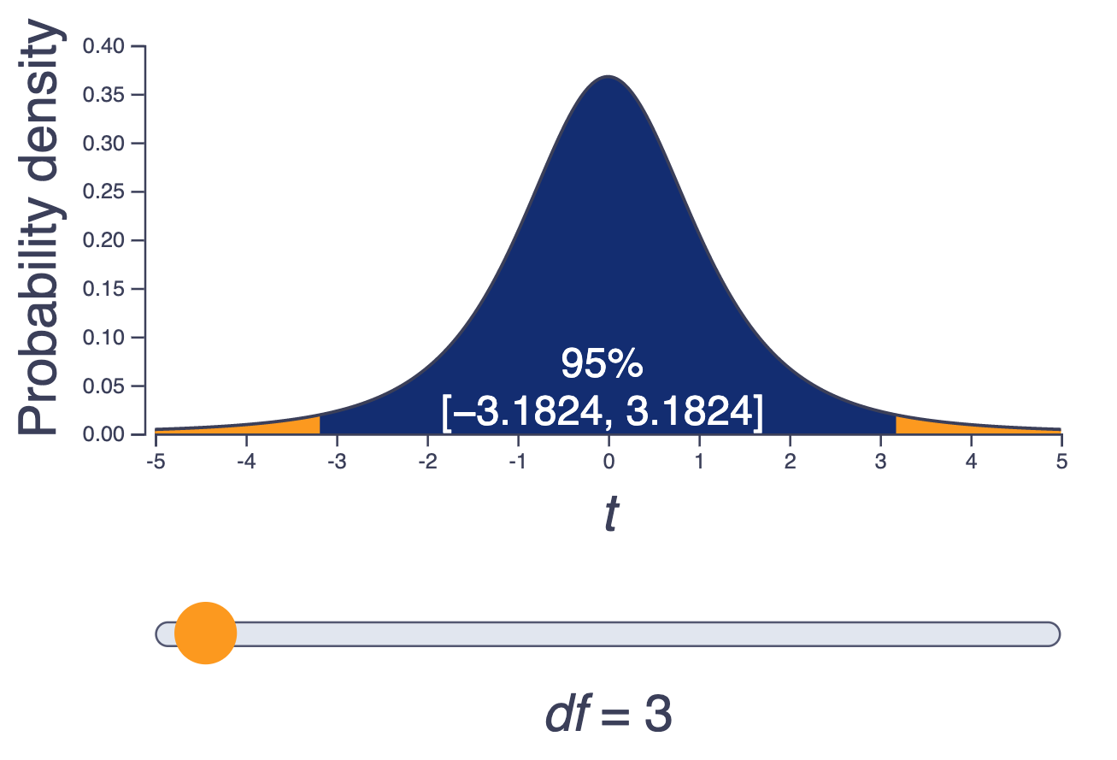
The t-distribution
Instead, we can use the t-distribution
Looks like normal, by isn’t.
Defined by degrees of freedom (df) - calculated as N-1 (number of observations minus 1)
The “critical t value” will change for different degrees of freedom.
It’s the value we use instead of 1.96 to calculate 95% confidence intervals
Interactive visualisation

Slide 46
The t-distribution
Instead of multiplying the standard error by 1.96, we multiply by the critical t value.
Critical t gets closer to 1.96 with larger sample - the t-distribution itself will approximate normal distribution more closely
For example, in our sample of 4, the df is 4 - 1 = 3. Move the slider to df = 3 to see that the critical t value for 3 is 3.182
Interactive visualisation

Slide 47
t-based confidence intervals:
Average doomscrolling time for the sample: 101 minutes
Standard error: 6.095
Critical t value: 3.182
CI Limits = mean ± 3.182 x SE CI Limits = 101 ± 3.182 x 6.095 CI Limits = [81.606, 120.394]

Slide 48
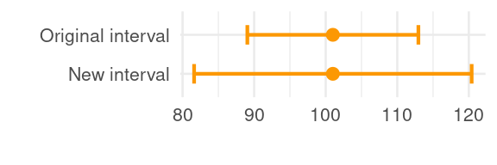
t-based confidence intervals
Compare the new confidence interval [81.61, 120.394] with the confidence interval we got using the value 1.96: [89.05, 112.95]. The new CI is wider!

Slide 49
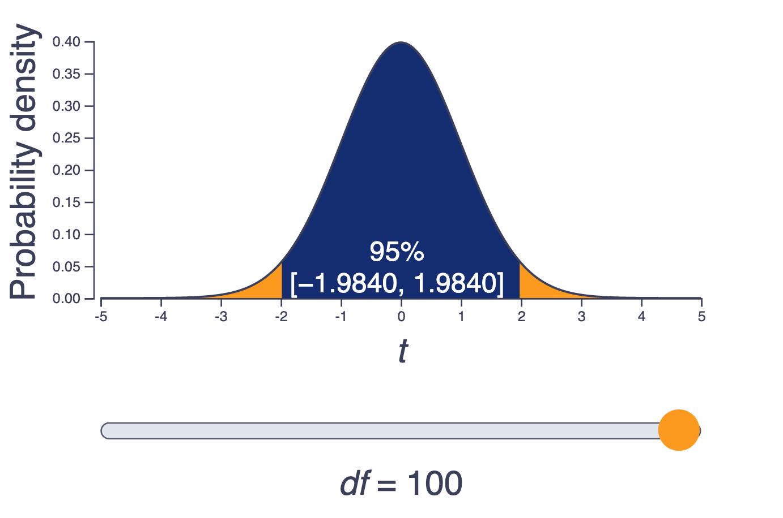
t-based confidence intervals:
This is to be expected - we have a tiny sample (N = 4), so there is a lot of uncertainty around whether the estimate of 101 minutes is actually representative of the population.
The larger the sample, the tighter the confidence intervals,. because the critical t gets smaller and smaller (note how t approaches 1.96 as the sample size (df) increases)

Slide 50
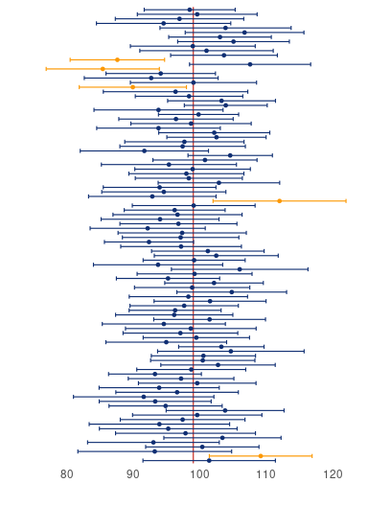
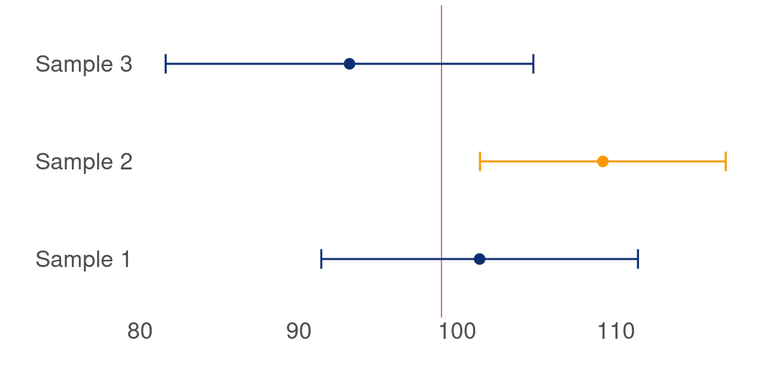
Confidence intervals across samples
We take samples over and over again, compute the mean for each, and construct confidence intervals around that mean - 95% of them will contain the population value, the remaining 5% will not.
This is known as an interval with 95% coverage. 95% is the most common value that we choose, but it can take on other values as well (e.g 50%, 90%, 99%).

Slide 51
How to interpret confidence intervals
The average doomscrolling time in our sample was 101 minutes (SD = 12.19) 95% CI [81.61, 120.39]."
Correct interpretation
ASSUMING THAT our sample is one of the 95% producing confidence intervals that contain the population value, then the population value for time spent doomscrolling per day falls somewhere between 81.61 and 120.39 minutes.
However…
There is no guarantee that the assumption above is correct! And we just have to live our lives not knowing…

Slide 52
How *not* to interpret confidence intervals
No:
“We can be 95% confident that the population value falls between 81.61 and 120.39.”
“95%” in the name refers to coverage, not to how confident we’re feeling.
Also no:
“There is 95% probability that the population value falls between 81.61 and 120.39.”
Think back to the “ladder” of confidence intervals - each of the intervals on that plot shows different limits. So the probability cannot be 95% for every single one of them.

Slide 53
How to interpret confidence intervals
Correct interpretation
ASSUMING THAT our sample is one of the 95% producing confidence intervals that contain the population value, then the population value for time spent doomscrolling per day falls somewhere between 81.61 and 120.39 minutes.
More general correct interpretation
ASSUMING THAT our sample is one of the 95% producing confidence intervals that contain the population value, then the population value for the estimate of interest falls somewhere between the lower limit the upper limit of the interval we’ve computed for our sample.
Memorise and practice!

Slide 54
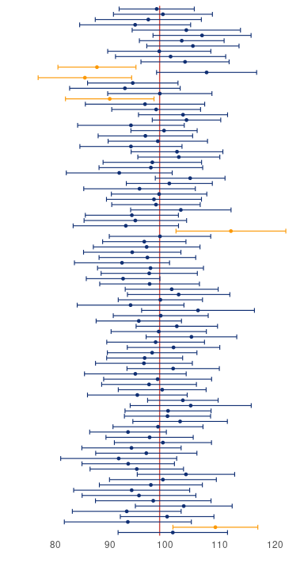
The bigger picture…
When interpreting estimates and confidence intervals for your sample - always consider them as just one of many different possible estimates
This is why replication is important in science - our sample could easily be the one that misses the population value
Always be vary of studies placing too much certainty on a single finding

Slide 55
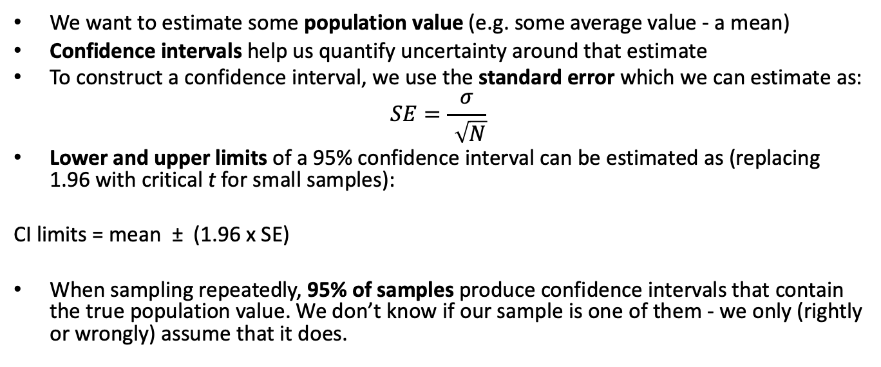
Summary
We want to estimate some population value (e.g. some average value - a mean)
Confidence intervals help us quantify uncertainty around that estimate
To construct a confidence interval, we use the standard error which we can estimate as:
$$SE=\frac{σ}{\sqrt{N}}$$
Lower and upper limits of a 95% confidence interval can be estimated as (replacing 1.96 with critical t for small samples):
CI limits = mean ± (1.96 x SE)
When sampling repeatedly, 95% of samples produce confidence intervals that contain the true population value. We don’t know if our sample is one of them - we only (rightly or wrongly) assume that it does.

Slide 56
Next week:
Putting it all into practice:
Research questions
Good and lss good hypotheses
Testing hypotheses with Null Hypothesis Significance Testing
A disappointing answer to why we’re so obsessed with the value 95%.

Slide 57
References
Sharma, Bhakti, Susanna S. Lee, and Benjamin K. Johnson. 2022. “The Dark at the End of the Tunnel: Doomscrolling on Social Media Newsfeeds.” Technology, Mind, and Behavior 3 (1). https://doi.org/10.1037/tmb0000059.

